Slide 1

Notes:
I say it every year- you all should be very proud of yourselves for making it this far
It’s a big deal that you spent a full weekend dedicated to innovation and challenging yourself to come up with something that you’d eventually show off to your peers and the judges- especially for those of you who go back to school tomorrow!
Judges just spent the last 3 hours reviewing your videos submissions based on the following criteria:
Innovation/Ambition
User Interface/User Experience
Solution Impact
Overall Quality
It was a very difficult decision and took lots of deliberation, but the teams that have been selected to move forward are….
*NEXT SLIDE*

Slide 2
High School Division
Team 1
Team 2
Team 3
Team 4
Notes:
*Read off teams!*
You’ll have 5 minutes to present and the judges will have 5 minutes to ask you questions
Virtual participants- we will have a timer going for you, and you will be able to hear when it goes off. Please feel free to track your time on your own as well. In Person participants, we have this timer for you
Teams, we wll have about 30 minutes before final presentations by these top teams begin.
In the meantime, Joseph will be giving out prizes from the tickets you all received this weekend!

Slide 3
College Division
Team 1
Team 2
Team 3
Team 4
Notes:
*Read off teams!*
You’ll have 5 minutes to present and the judges will have 5 minutes to ask you questions
Virtual participants- we will have a timer going for you, and you will be able to hear when it goes off. Please feel free to track your time on your own as well. In Person participants, we have this timer for you
Teams, we wll have about 30 minutes before final presentations by these top teams begin.
In the meantime, Joseph will be giving out prizes from the tickets you all received this weekend!

Slide 4
Notes:
Welcome back everyone!
We are now ready for the final round of presentations! Before we get started, let’s take a look at some of the prizes you might win this weekend!

Slide 5
Grand Prizes
The judges will select the top two teams from each level. Each member will win one of these valuable prizes…
Notes:
Judges will be selecting the top 2 teams from each level, high school and college
Each member of the winning teams will win one of the following prizes:
*Next Slide*

Slide 6

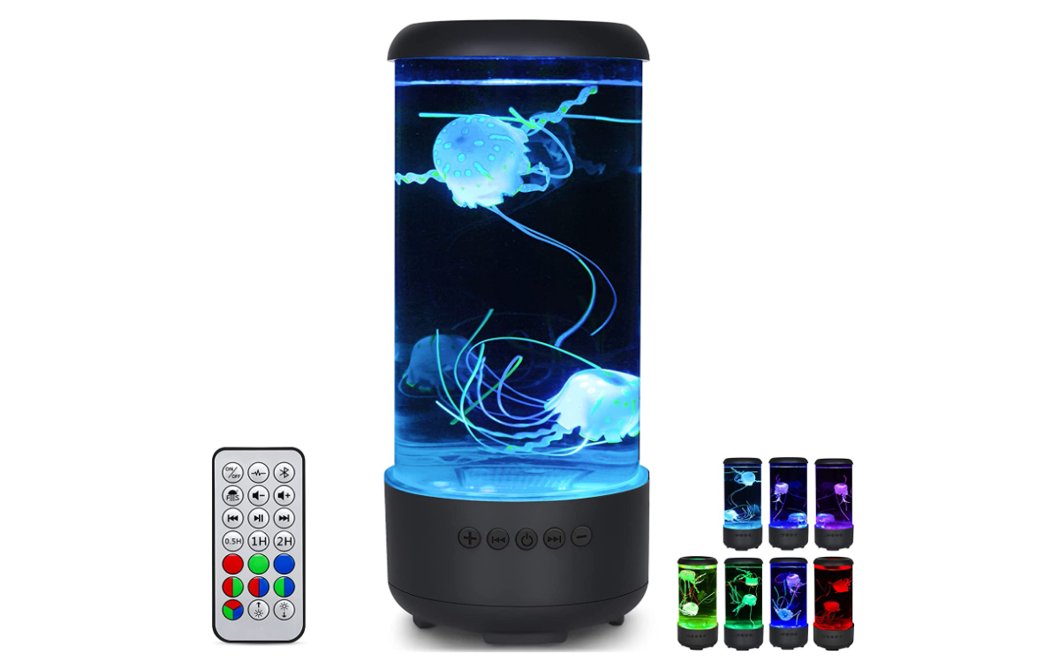
Second Place: Pick One
Pixel Art Bluetooth Speaker*
LED Jellyfish Lamp*
Notes:
LED lamp: https://www.amazon.com/dp/B0B8R4T5HX/
Pixel Art Speaker: https://www.amazon.com/dp/B0811XB8VB/ref=cm_gf_acbr_iaac_d_p0_e0_qd0_NUOdAM3fFvGTmlUdfhxg

Slide 7
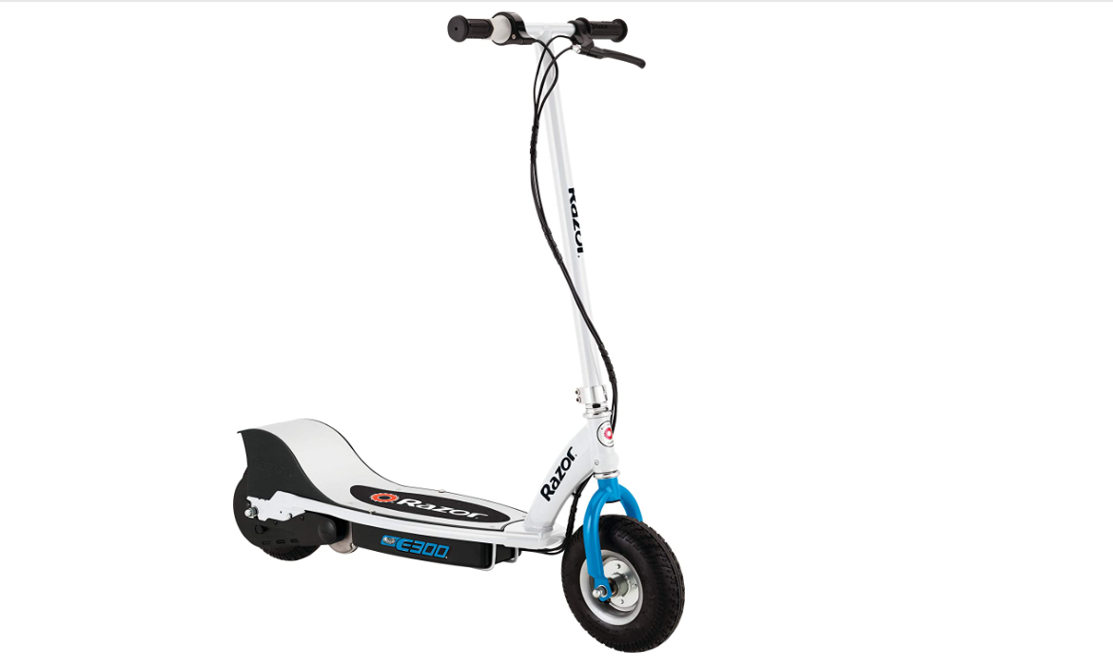
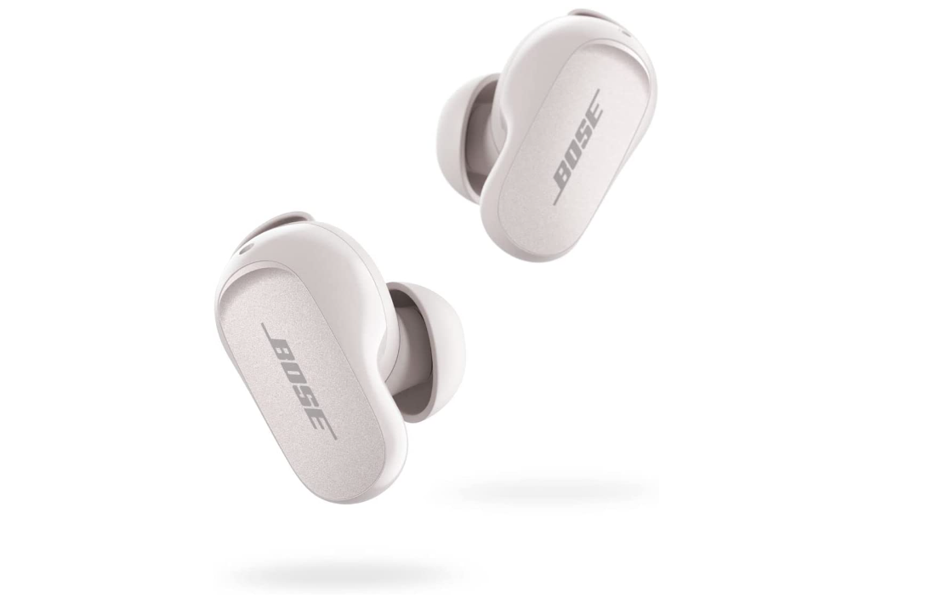
First Place: Pick One
Electric Scooter*
Bose Noise Cancelling Earbuds*
Notes:
Bose Earbuds: https://www.amazon.com/dp/B0B7838HH6/
Electric Scooter: https://www.amazon.com/Razor-E300-Electric-Scooter-White/dp/B083G8KWCY
International prizes may vary, but will be of equal value!
Now that you know what the prizes are, let me introduce you to our wonderful panel of judges:
*Next Slide*

Slide 8

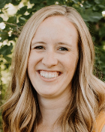
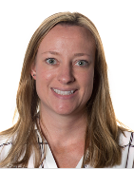

Meet Your Judges
Quinton Robinson
Manager,
Software Engineering
Alyssa Levicky
Director,
R&D
Chrystal Legan
Senior Manager,
Sales Engineers
Derek Walker
SVP,
Engineering
Notes:
We are so thankful for these 4 individuals for joining us today!
Teams will have 5 minutes to present and the judges will have 5 minutes to ask questions following the presentation.
The teams have been selected to present in random order, and with that we’re going to kick off presentations with
*next slide*

Slide 9
Notes:
Thank you teams for your wonderful presentations!!
We will now break for dinner; we have marinara pasta, salad, dinner rolls and cookies for you to enjoy while the judges deliberate and select the winners.
Enjoy your meals! We will be back shortly.

Slide 10
🦸‍♀️
Superlatives
EXCELLENT
Recognizing teams nominated by mentors
🦆 🦆 🦆 🦆 🦆 🦆 🦆 🦆 🦆 🦆 🦆 🦆
Notes:
Individuals from these teams will each receive a rubber duck of their choice!

Slide 11
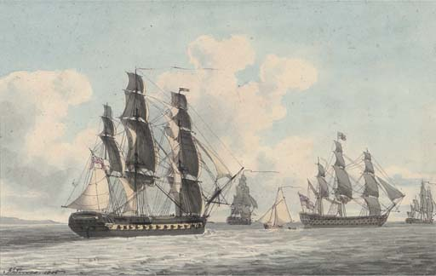
Shaker Heights
Indefatigable
For tireless effort throughout the weekend
“I don't know if they have stopped all weekend, or even left their chairs at all...”

Slide 12
OG Boss Lady
TerGIFfic
For best use of gifs and pictures in the Discord
“I'd like to make a superlative nomination for OG Boss Lady for most GIFs used hahaha”

Slide 13
Giveaway!
2023 Hyland Hackathon
Notes:
Now it’s time for our giveaway! You’ve all been earning tickets throughout the weekend… let’s see who comes away with some items.

Slide 14
Giveaway
Names will be chosen deterministically
Based on tickets earned
Selected individuals will pick their item
Ten participants will be selected
Grab Bag
A.I. Art
Stuffed Animal
Audible Credit
👈In-Person
Duck Bag
Bonus Track
Water Bottle
Virtual 👉
A.I. Poetry
Candy Bag
Udemy Course
Notes:
We are going to choose ten people – they will each select one!
Grab Bag – could be anything?????
Duck Bag – a bag of random rubber ducks
Candy Bag – a bag of large candy bars
Stuffed Animal – the most adorable inanimate friend you could want
Water Bottle – with a snowflake on it!
Audible credit – get yourself an audiobook
AI Poetry/Art – work to create some custom poetry or art using the power of GPT-3 and DALL-E
Bonus Track – work to create a custom synth track for any purpose you desire
Udemy Course – level up your skills even further by selecting from some different udemy courses

Slide 15
Survey!
tinyurl.com/hackhyland2023
Notes:
We have one last thing to ask – please complete our feedback survey. We are always trying to make things better, and only you can let us know how to do that! Go to tinyurl.com/hackhyland2023 and scroll down to “After the Event” to find the link. Please be honest and thorough with your feedback.

Slide 16
Notes:
And now, we wait….

Slide 17
And now for the grand winners…
Hyland Hackathon 2023
Notes:
Now the moment you all have been waiting for!
If you are selected as a winner, please be sure you stay back to take a group photo with our panel of judges!
With that…
*next slide*

Slide 18
High School Division Runner Up
2nd Place Winners

Slide 19
College Division Runner Up
2nd Place Winners

Slide 20
High School Division Winner
1st Place Winners

Slide 21
College Division Winner
1st Place Winners

Slide 22
Thank You!
2023 Hyland Hackathon
Notes:
Thank you so much!
We hope to see you back next year!
Advance slide for outro music

Slide 23

Notes:
Thank you so much!
We hope to see you back next year!

